Slide 1
.NET 6
Long Term Evolution ?
Leszek Kowalski Michał Bryłka Capgemini

Slide 2
Agenda
NET 6
New Features
API improvements
Performance improvements
C# 10.0
New features
Demo
Discussion Panel

Slide 3


Inner-Loop Performance
Hot Reload
Types
Iterators
Async/await expressions
LINQ expressions
Lambdas
Dynamic objects
Renaming elements
Deleting namespaces, types and members
Adding or modifying generics
Modifying interfaces
Modifying method signatures

Slide 4
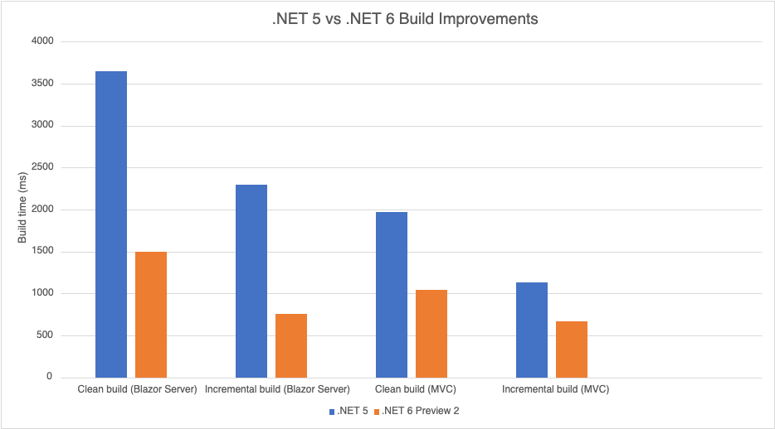
Inner-Loop Performance
MSBuild Speedup

Slide 5


Package Validation Tooling
dotnet add package Microsoft.DotNet.PackageValidation
<Sdk Name="Microsoft.DotNet.PackageValidation" Version="1.0.0-preview.5.21302.8" />
<PackageValidationBaselineVersion>1.0.0</PackageValidationBaselineVersion>
breaking changes across package versions.

Slide 6
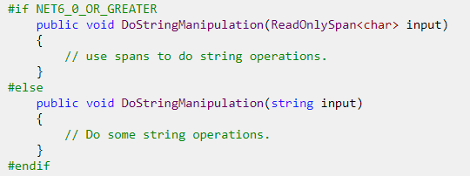
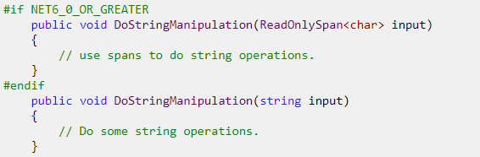
Package Validation Tooling
Inconsistent API between target frameworks

Slide 7
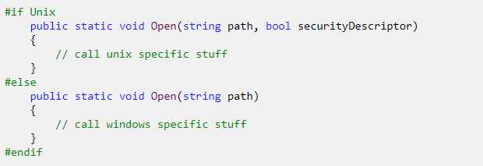
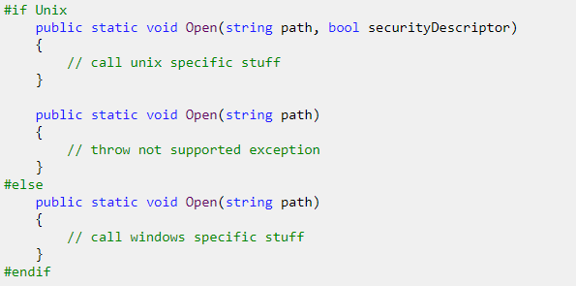
Package Validation Tooling
Inconsistent API on different runtimes
https://devblogs.microsoft.com/dotnet/package-validation/

Slide 8
API Improvements
Date/Time
DateOnly var date = new DateOnly(2021, 10, 19); Console.WriteLine(date); int dayNumber = date.DayNumber;//738081 var date2 = DateOnly.FromDayNumber(2); //0..3_652_058 DateOnly.FromDateTime(…)
TimeOnly var time = new TimeOnly(12, 13, 14, 140); long ticks = time.Ticks;//439941400000 var time2ms = new TimeOnly(10 * 1000 * 2); //2 ms var max = TimeOnly.MaxValue;//23:59:59.999 var startedAt = new TimeOnly(8, 15); var finishedAt = new TimeOnly(16, 25); TimeSpan difference = finishedAt - startedAt; var parsed= TimeOnly.Parse("10:23 PM", CultureInfo.GetCultureInfo("pl-pl")); //22:23

Slide 9
API Improvements
LINQ
var numbers = Enumerable.Range(1, 100);
Chunk var chunks = numbers.Chunk(8); 1, 2, 3, 4, 5, 6, 7, 8 … 89, 90, 91, 92, 93, 94, 95, 96 97, 98, 99, 100
numbers.FirstOrDefault(x => x > 500, -1); numbers.SingleOrDefault(x => x > 99, -1);
record Person(string Name, int Age); Console.Write(developers.MaxBy(x => x.Age)); //Person { Name = Przemek K, Age = 40 }
MinBy
Who needs MoreLinq now?

Slide 10
API Improvements
LINQ
var numbers = Enumerable.Range(1, 100);
System.Index support numbers.ElementAt(^1)
System.Range support numbers.Take(15..20)
3 parameter Zip overload
Non-enumeration count numbers.TryGetNonEnumeratedCount(out var count)

Slide 11
API Improvements
Collections
EnsureCapacity for List, Stack, Queue (but not Collection…)
CollectionsMarshal.AsSpan
CollectionsMarshal.GetValueRefOrNullRef
Unsafe.IsNullRef
StringComparer
IsWellKnownOrdinalComparer(comparer, out bool ignoreCase);
IsWellKnownCultureAwareComparer(comparer, out CompareInfo compareInfo, out CompareOptions compareOptions);

Slide 12
API Improvements
PriorityQueue
var shopQueue = new PriorityQueue<string, Job>();
shopQueue.Enqueue("Michał", Job.Developer);
shopQueue.Enqueue("Wojciech", Job.Physicist);
shopQueue.Enqueue("Jarosław", Job.Politician);
while (shopQueue.TryDequeue(out string? name, out Job _))
Console.WriteLine($"Serve now {name}");
public enum Job { Physicist, Developer, Politician }
// Serve now Wojciech
// Serve now Michał
// Serve now Jarosław

Slide 13
API Improvements
File and I/O
public FileStream(SafeFileHandle handle, FileAccess access, int bufferSize, bool isAsync)
Changes to FileStream.Position
Not serialized to OS
Updated after async operations
Preallocation size and options (RandomAccess, DeleteOnClose, …) specification sealed record FileStreamOptions(/*..., */ FileOptions Options, int BufferSize = 4096, long PreallocationSize);
Vectored (scatter/gather) I/O
Atomicity
Concatenated output
Efficiency
GetLength: faster 33 Times
SeekForward/SeekBackward: 10-100 times faster
Read/WriteAsync: up to 5 times faster
Read/Write: up to 6 times faster

Slide 14
API Improvements
Native alloc
unsafe
{
int* number = (int*)NativeMemory.Alloc(sizeof(int));
*number = 42;
int* numbers = (int*)NativeMemory.Alloc(2, sizeof(int));
numbers[0] = 42;
numbers[1] = 420;
numbers++;
var n = *numbers;
NativeMemory.Free(number);
NativeMemory.Free(numbers);
}

Slide 15
API Improvements
Async
WaitAsync public Task WaitAsync(CancellationToken cancellationToken); public Task WaitAsync(TimeSpan timeout); public Task WaitAsync(TimeSpan timeout, CancellationToken cancellationToken); TimeSpan instead of int !!!
CancellationTokenSource.TryReset if (!cts.TryReset()) cts = new CancellationTokenSource();

Slide 16
API Improvements
Timer
Timers
System.Threading.Timer, System.Timers.Timer
System.Windows.Forms.Timer, System.Windows.Threading.DispatcherTimer
System.Web.UI.Timer
PeriodicTimer
Single consumer only
Callback-less aproach with async, no sync-over-async
var timer = new PeriodicTimer(TimeSpan.FromSeconds(100));
while (await timer.WaitForNextTickAsync()){ }

Slide 17
API Improvements
Nullables
void PerformWork(string text) { if (text == null) { throw new ArgumentNullException("text"); } }
void PerformWork2(string? text) { var localText1 = text ?? "default"; var localText2 = text ?? throw new ArgumentNullException(nameof(text)); }
void PerformWork3(string? text) { ArgumentNullException.ThrowIfNull(text); }
Or use NRT !!!

Slide 18
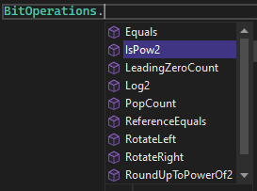
API Improvements
Community-driven
int pid = Environment.ProcessId; string path = Environment.ProcessPath;
byte[] bytes = RandomNumberGenerator.GetBytes(200);
await Parallel.ForEachAsync() (DEMO)

Slide 19
API Improvements
Community-driven
var tcs = new TaskCompletionSource();
PosixSignalRegistration.Create(PosixSignal.SIGINT, context =>
{
Console.WriteLine($"{context.Signal} fired");
tcs.TrySetResult();
});
await tcs.Task;

Slide 20
C# 10 – head line features
Value (readonly) Records + record-like semantics
Interpolated string enhancements
File Scoped Namespaces
Global Using Statements
Implicit Using Statements
Lambda improvements

Slide 21
Interpolated string handlers
public class Person {
public string Name { get; }
public int Age { get; }
public override string ToString() => $"{nameof(Name)}: {Name}, {nameof(Age)}: {Age,4}";
}
//NET6: public override string ToString()
{
var h = new DefaultInterpolatedStringHandler(6, 4);
h.AppendFormatted("Name");
h.AppendLiteral(": ");
h.AppendFormatted(this.Name);
h.AppendLiteral(", ");
h.AppendFormatted("Age");
h.AppendLiteral(": ");
h.AppendFormatted<int>(this.Age, 4);
return h.ToStringAndClear();
}
//NET5
public override string ToString() =>
string.Format( "{0}: {1}, {2}: {3,4}", new[]{ "Name", this.Name, "Age", this.Age });

Slide 22
Constant Interpolated Strings
const string S1 = "Hello world"; const string S3 = $"{S1} Kevin, welcome to the team!";
[DebuggerDisplay($"Count: {nameof(Count)}")] class MyList { public int Count { get; private set; } = 15; }

Slide 23
File Scoped Namespaces
namespace MySystem; class MyClass { }
One per file
Not nested

Slide 24
Global Using Statements
Project-scoped defaults global using System; global using System.Collections.Generic; global using System.IO; global using System.Linq;
Can be static global using static System.Math;
Can use mnemonic using SF = Microsoft.CodeAnalysis.CSharp.SyntaxFactory;

Slide 25
Implicit Using Statements
*.csproj: <ImplicitUsings>enable</ImplicitUsings>
<PROJECT_NAME>.GlobalUsings.g.cs global using global::System; global using global::System.Collections.Generic; global using global::System.IO; global using global::System.Linq; global using global::System.Net.Http; global using global::System.Threading; global using global::System.Threading.Tasks;
<ItemGroup> <Using Remove="System.Threading" /> <Using Include="Microsoft.Extensions.Logging" /> </ItemGroup>

Slide 26
Minimal APIs
Without Rust or Go…
var builder = WebApplication.CreateBuilder(args);
var app = builder.Build();
app.MapGet("/hello", () => "Hello, World!");
app.Run();

Slide 27
Record struct
readonly record struct Rect(
int X,
int Y,
int Width,
int Height);

Slide 28
Record improvements
record class Rectangle(int Width, int Height) {
public sealed override string ToString() => $"{GetType().Name} {Width}x{Height}";
}
record class Square (int side): Rectangle(side, side) {
//public override string ToString() => $"{GetType().Name} {Width}x{Height}";
}

Slide 29
„Record” improvements
readonly struct RectangleStruct {
public int X { get; init; } public int Y { get; init; }
public int Width { get; init; } public int Height { get; init; }
public RectangleStruct() { X = Y = 0; Width = Height = 1; }
public RectangleStruct(int x, int y, int width, int height) { X = x; Y = y; Width = width; Height = height;
}
}
var r3 = new RectangleStruct(1, 2, 3, 4);
var r4 = r3 with { X = 15 };
with „almost” everywhere

Slide 30
Extended property patterns
C# 9 if (e is MethodCallExpression { Method: { Name: "MethodName" } })
C# 10 if (e is MethodCallExpression { Method.Name: "MethodName" })

Slide 31
Lambda enhancements
var f1 = string () => default; var f2 = ref int (ref int x) => ref x; var f3 = void () => { }; var f4 = async (int i) => i;
Method(int (i) => i); static void Method<T>(Func<T, T> f) { }
Func<string,int> func = int.Parse; MyParser mp = func; public delegate int MyParser(string arg);

Slide 32
Performance improvements
Runtime
Inlining and devirtualization
Sealed types
Eliminate bounds checking if (array.Length >= 4) array[3] = ‚A’;
Folding for System.Math double GetHeight(double longbase, double shortbase, double leftLeg, double rightLeg) { double x = (Math.Pow(rightLeg, 2.0) - Math.Pow(leftLeg, 2.0) + Math.Pow(longbase, 2.0) + Math.Pow(shortbase, 2.0) - 2 * shortbase * longbase) / (2 * (longbase - shortbase)); return Math.Sqrt(Math.Pow(rightLeg, 2.0) - Math.Pow(x, 2.0)); }
Vectorizations (PopCount, fdiv, RotateRight, …)
Lowering (x % 2 == 0, HasFlag, …)

Slide 33
Performance improvements
Framework
Parsing for build-in types from ROS<>
Guid, Version, Enum (?)
Remove allocs
Random,
Environment (GetEnvironmentVariables, ProcessId, ProcessPath),
DateTime (UtcNow, Now)
Enum (IsDefined, GetName, GetNames)
Array (Clear, Fill)
Vectorization
String (Replace, IndexOf)

Slide 34
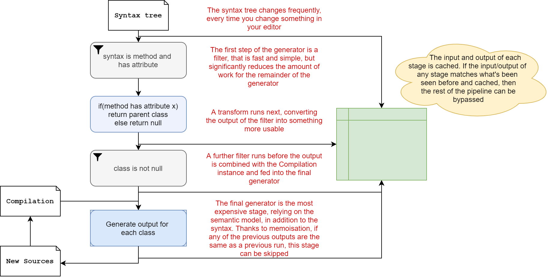
Code generator
Incremental generators
System.Text.Json – allocation issues
Faster approach needed - define pipelines and filters
IIncrementalGenerator

Slide 35
Code generator use
public class TestController { private readonly ILogger<TestController> _logger;
public TestController(ILogger<TestController> logger) => _logger = logger;
[HttpGet("/")] public string Get() { if (_logger.IsEnabled(LogLevel.Information)) _logger.LogInformation("Writing hello world response");
return "Hello world!"; } }

Slide 36
Code generator use
class TestController {
private static readonly Action<ILogger, Person, Exception?> __LogHelloWorldCallback
= LoggerMessage.Define<Person>(
LogLevel.Information,
new EventId(0, nameof(LogHelloWorld)),
"Writing hello world response to {Person}");
void LogHelloWorld(Person person)
{
__LogHelloWorldCallback(_logger, person, null);
}
}

Slide 37
Code generator use
public partial class TestController { [LoggerMessage(0, LogLevel.Information, "Writing hello world response to {Person}")] partial void LogHelloWorld(Person person); }
OR Static: [LoggerMessage(Message = "Writing hello world response to {Person}")] partial void LogHelloWorld(LogLevel logLevel, Person person);
dynamic log levels are not compatible with LoggerMessage.Define() ☹

Slide 38
Code generator use
System.Text.Json gen
record Animal(string? Name, AnimalKind Kind, AnimalFood Food);
[JsonSerializable(typeof(Animal))] partial class MyJsonContext : JsonSerializerContext { }
public static void TestJsonGen() { var animal = new Animal("Lion", AnimalKind.Mammal, AnimalFood.Carnivorous); byte[] utf8Json = JsonSerializer.SerializeToUtf8Bytes(animal, context); var newAnimal = JsonSerializer.Deserialize(utf8Json, context); }

Slide 39
Caller Argument Expression
aka. FluentAssertions vNext
static void Assert(bool condition,
[CallerArgumentExpression("condition")] string message = null)
=> Debug.Assert(condition, message);
May only be used on parameters with default values
Multiple parameters marked with CallerArgumentExpression are permitted
For invalid parameter names compiler will pass in an empty string
Sadly no nameof support

Slide 40
Demo

Slide 41
Discussion

Slide 42
The end
Thank you for your attention

